Slide 1
2021 International Wisdom Summit Wisdom & culture diversity Panel Discussion
Melody Manchi Chao
The Hong Kong University of Science and Technology
2021-10-11

Slide 2
Wisdom & Culture Diversity
Dr. Michael Harris Bond
Perceiving Another as Wise
Dr. Xindong Wei (speaker) & Dr. Fengyan Wang
Solomon is WEIRD
Dr. H. Clark Barrett
Unwise Choices and the Landscape of Morality

Slide 3
The cultural puzzle
What is wisdom?
Being effective in a given cultural system?
Is it “wise” if it is a cultural default or it is “wise” only if it is uncommon?
Interdependent self vs. independent self
Duty to know
Declarative knowledge?
Different reaction to intentional vs. accidental wrongdoings
Different expectations about what people “should know”

Slide 4
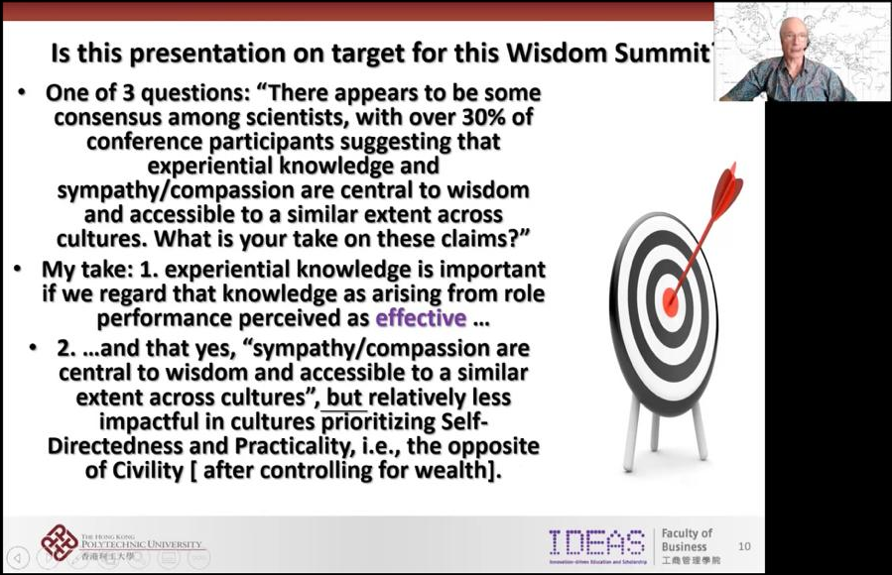
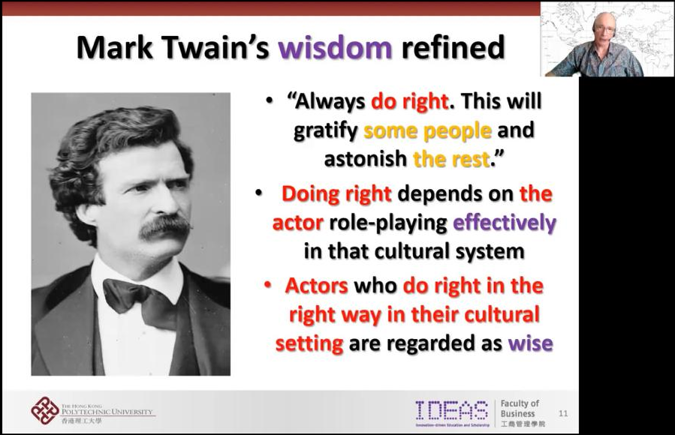
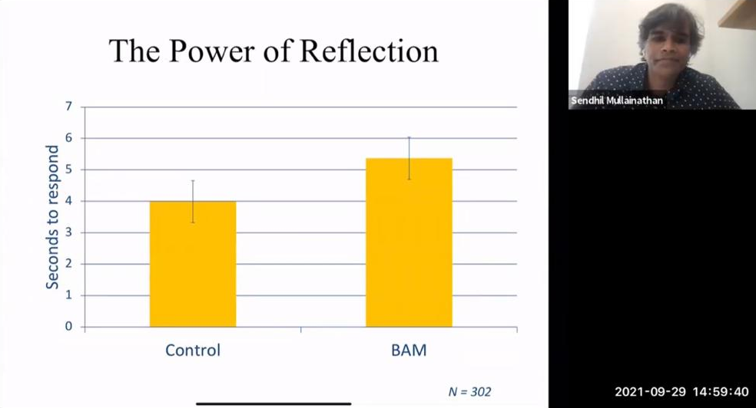
The cultural puzzle
Michael Harris Bond
What is wisdom?
Being effective in a given cultural system
Effective = Culture fit? Norm adherence?
Sympathy/compassion
Not the default in cultures prioritizing self-directness & practicality
Wise or not?
Cultural misfit:
Not impactful → not part of being wise, or wise but not useful?
Rare & uncommon; Counter dominant norm → part of being wise?
Wisdom & culture (norm adherence)
Outcome: Fit in vs. not?
Process: Awareness of fit vs. misfit
Observable action
Unobservable deliberation

Slide 5
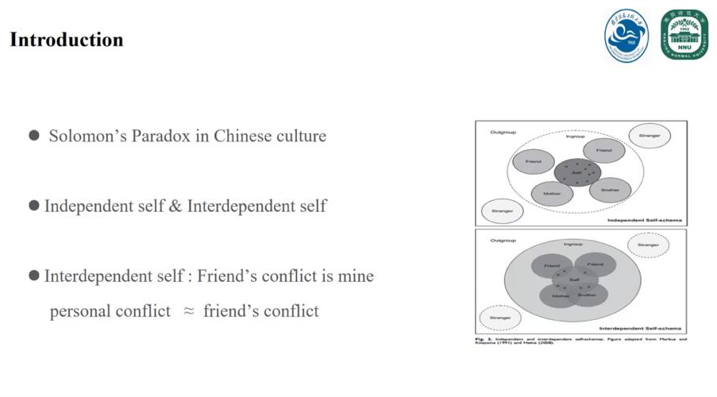
The cultural puzzle
Xindong Wei & Fengyan Wang
What is wisdom?
Wisdom: Interdependent > independent self?
Is it still considered as “wise” if it is a cultural default or it is “wise” only if it is uncommon?
Wisdom & culture (norm adherence)
Outcome: What is the final decision you made for your friend?
Process: Awareness of the potential options your friend might have (but might go for the cultural default or not)
Articulated decision
Unobservable deliberation

Slide 6
The cultural puzzle
Accessibility universals are psychological processes that exist in all cultures, are used to solve the same problem across cultures, and are accessible to the same degree across cultures - i.e., the likelihood of a person using this psychological process is similar across culture
Clark Barrett
What is wisdom?
Duty to know
Different reaction to intentional vs. accidental wrongdoings
Different expectations about what people “should know”
Declarative knowledge
Specific content?
Process of deriving knowledge?
Observable
Non-universals are psychological processes that do not exist in all cultures.
Unobservable

Slide 7
The cultural puzzle
An observation
Wisdom discourses:
Highlights processes (cognitive, emotion, motivation,...)
Culture & wisdom discourses:
Focuses on the observable (usually differences)
Needs to consider the unobservable (processes)?
More commonalities than differences?

Slide 8
2021 International Wisdom Summit Wisdom & culture diversity Panel Discussion
Melody Manchi Chao
The Hong Kong University of Science and Technology
2021-10-11

